Slide 1
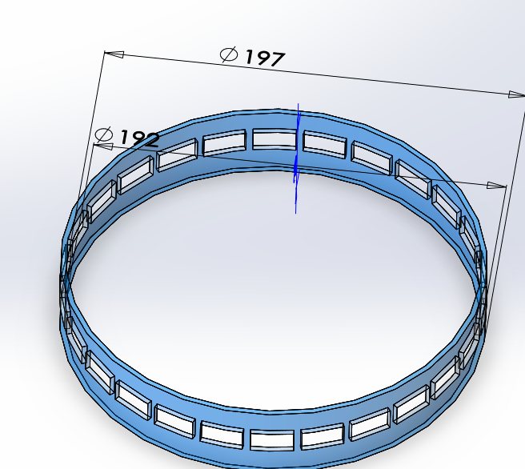
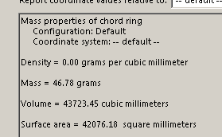
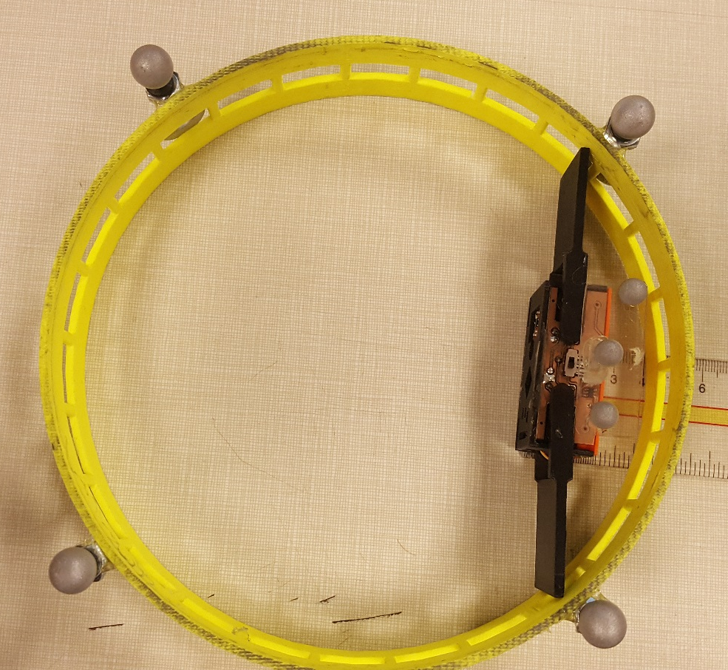
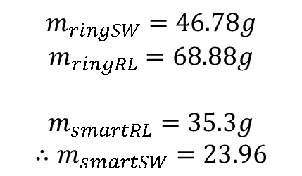
$$m_{ringSW}=46.78g$$
$$m_{ringRL}=68.88g$$
$$m_{smartRL}=35.3g$$
$$∴m_{smartSW}=23.96$$
Inner circumference taken up by smarticle is 16cm
Total inner circumference = 60.32 cm
Smarticle takes up 26.53% of inner ring
Weight of straight part of chord (before smarticle addition) must weigh: .2653*46.76=12.41g (in solidworks)
4cm

Slide 2
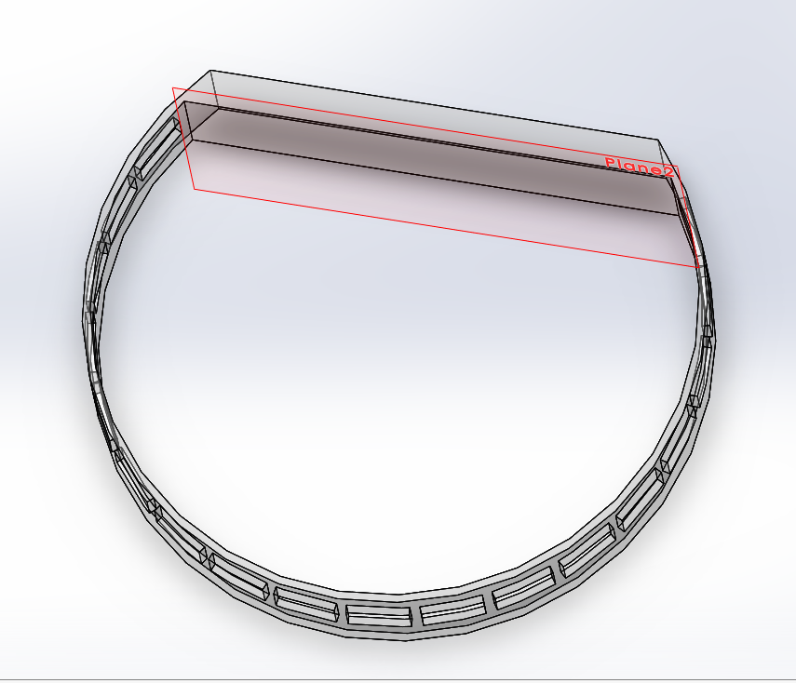
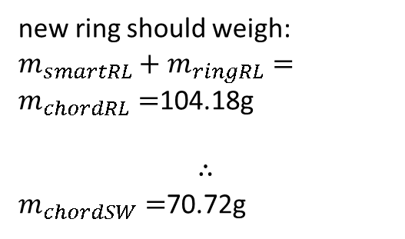

This must be weight of smarticle + 26.53% of old ring
$$251°$$
New ring should weigh
new ring should weigh:
$m_{smartRL}+m_{ringRL}=m_{chordRL}=$104.18g
$$∴$$
$m_{chordSW}=$70.72g

